Slide 1
MAR 580: Advanced Population Modeling for Management of Living Marine Resources
Lecture 12
Management Strategy Evaluation
www.mycourses.umassd.edu
Acknowledgements: André Punt, Sally Wayte, Jason Link
1 December 2015

Slide 2
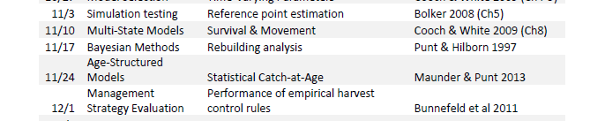
Today’s Outline
Management Strategy Evaluation
Application to Sebastes electronicus
Lab exercise
Testing the performance of an empirical data-poor harvest control rule.

Slide 3

Reading
Also:
Butterworth and Punt (1999)
Smith et al. (1999)
Sainsbury et al. (2000)
Punt et al. (2015)

Slide 4
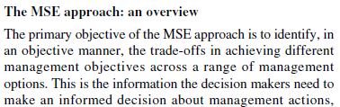
Management Strategy Evaluation (MSE)
“MSE uses simulation models within an adaptive framework that enables the comparison of alternative strategies in a virtual world under multiple (and often conflicting) objectives” (Smith et al. 1999).
Punt et al. (2001)

Slide 5
Management Strategy Evaluation
Powerful simulation approach for comparing performance of management strategies and modeling tools.
Look for impacts and tradeoffs, robustness
Check
monitoring (& indicators)
reference points
assessment methods
management strategies (including harvest rules)
implications of variation & error
Quantitative simulations, semi-quantitative usage

Slide 6
Story so far…
Lecture/Lab 8 (simulation testing)
Operating Model
(True System state)
Generate Simulated Data
Estimation Model
Performance Measures
(e.g. MARE)

Slide 7
Story so far…
Lecture/Lab 10 (population projections)
Real World
Data Collection
Estimation Model
Performance Measures
P(B>BMSY)
Harvest strategies
(fixed catches)
Population Projections

Slide 8
Management Strategy Evaluation (MSE)
Feedback loop between assessment model, harvest control rule, and operating model.
Operating Model
(True System state)
Generate Simulated Data
Estimation Model
Harvest control rules
Performance Measures

Slide 9
Management Strategy Evaluation
Management strategy comprised of:
Data collection
Assessment procedure
Harvest control rule (translate assessment results to scientific advice for management – catch advice)
Key difference from other simulation testing is feedback from the assessment procedure to the operating model via the harvest control rule.
Stock assessment forecasts focus on expectations of management decisions conditioned on estimates of system state.
MSE provides a way to evaluate how the error/bias associated with Estimation and Management implementation affects performance.

Slide 10
Management Conceptually
Punt et al. 2015. Fish & Fisheries

Slide 11
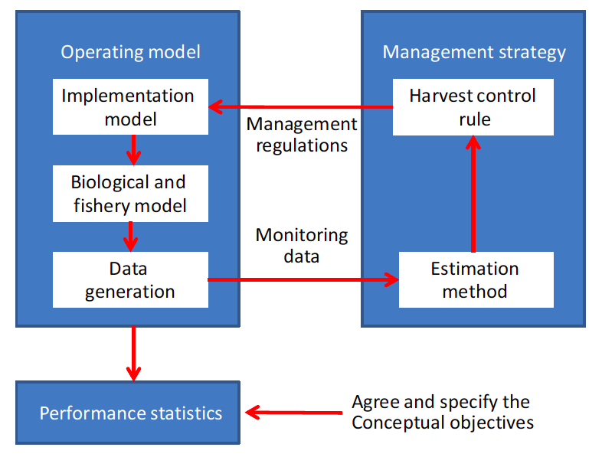
Management Strategy Evaluation (MSE)
Punt et al. 2015. Fish & Fisheries

Slide 12
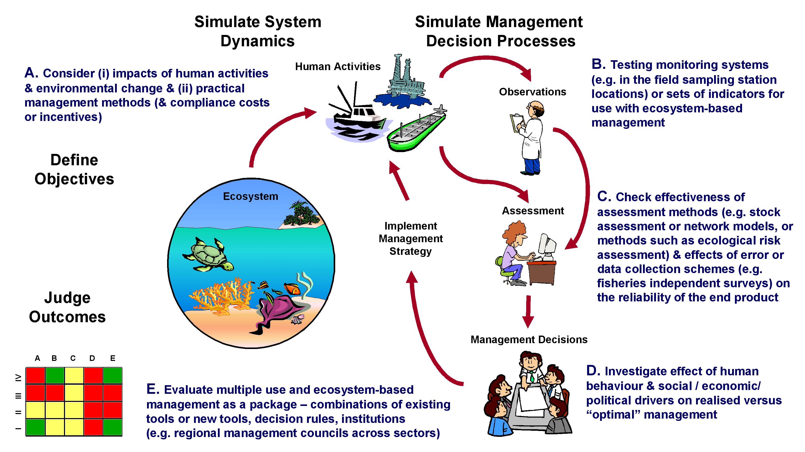
Management Strategy Evaluation
Redrawn with permission of Beth Fulton

Slide 13
Why do MSEs?
Evaluate full management cycle
Compare performance of management strategies against multiple management objectives, tradeoffs, model configurations, parameters, etc.
Identify sensitivity of management performance to system drivers and key uncertainty
Incorporate uncertainty
Pathway for formal decision analysis
Simulation cheap, Experimentation expensive
Play out ‘what if’ scenarios
Notes:
Stock assessment forecasts focus on management performance conditioned on estimates of system state.
MSE provides a way to evaluate how the error/bias associated with Estimation and Management implementation affects performance

Slide 14
A brief history….
First examples: Pacific Halibut (Southward 1968, Hilborn 1979)
International Whaling Commission: Evaluating the Revised Management Procedure (RMP) (e.g. Donovan 1989, Kirkwood 1997)
Robustness to many plausible system dynamics
South African fisheries (Management Procedure approach)
(e.g. Butterworth et al. 1999)
Single-species fisheries, technical interactions
Expanded to NZ fisheries, Australian fisheries, and large pelagics (SBT)
Empirical and Model-based Harvest control rules
Multiple Use Management (Australia, Sainsbury et al. 2000)
Coral Reef, habitat, communities (i.e. not fishing focused)
Multi-stock fisheries, economics (Great Barrier Reef, e.g. Mapstone 2008)
Single-species dynamics: multiple population drivers
e.g. Walleye Pollock, effects of climate & predation (A’mar et al. 2009)
Multiple species, Technical Interactions, Bioeconomics (Northern Prawn Australia, Dichmont et al.)
EBFM (Southeast Australia) (Fulton et al. 2014)
Data-poor harvest control rules (Wetzel, Carruthers et al. 2014)
Terrestrial conservation (Bunnefeld et al. 2011)

Slide 15
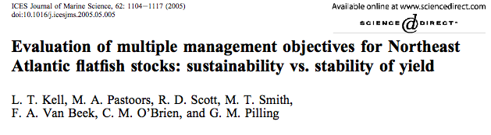
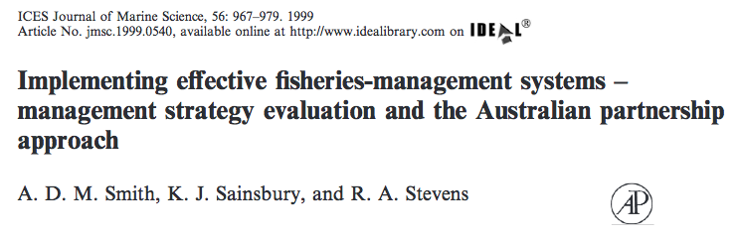
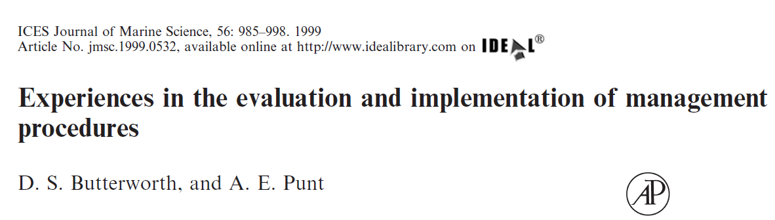
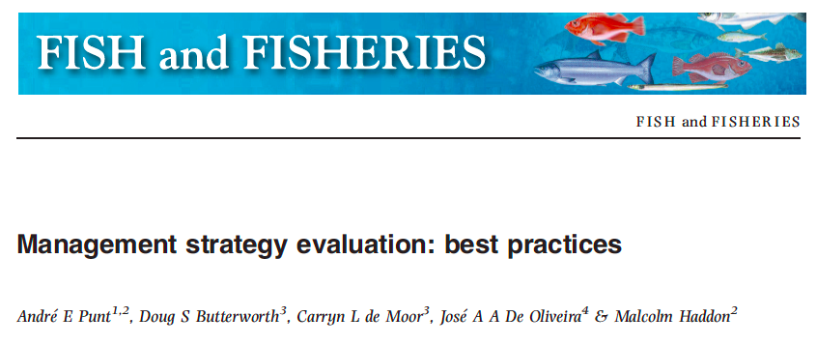


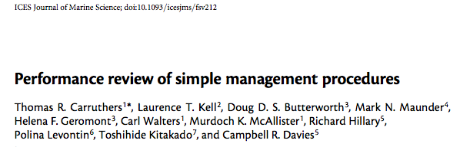
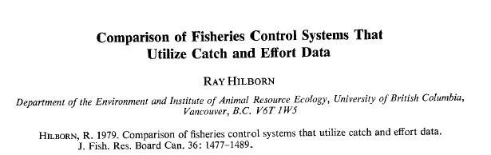

Slide 16
Objectives of MSE
Develop specific and operational management strategy for a particular fishery.
Evaluation of generic management strategies.
Identification of management strategies that will not work and should be eliminated from further consideration.
Quantify the ‘realizable’ performance which can be achieved given the quality of the data available and the types of uncertainties which are inherent in the system being managed.
Evaluation of the benefits of additional data collection.

Slide 17
Using MSE to flesh out viable management operational objectives
To examine tradeoffs in performance of alternative management strategies across a range of management objectives.
Not to find “optimal” solution.
To help decision makers, not prescribe outcomes.
Can incorporate wide range of objectives (including ecological and economic).

Slide 18
The Operating Model
Includes the biology of the system, the fishery, and how any data are generated.
Represents the “real world” for the analyses
Several operating models need to be considered: each is an alternative state of nature.
Several types of uncertainties (model, process, estimation, etc.) can be represented.

Slide 19
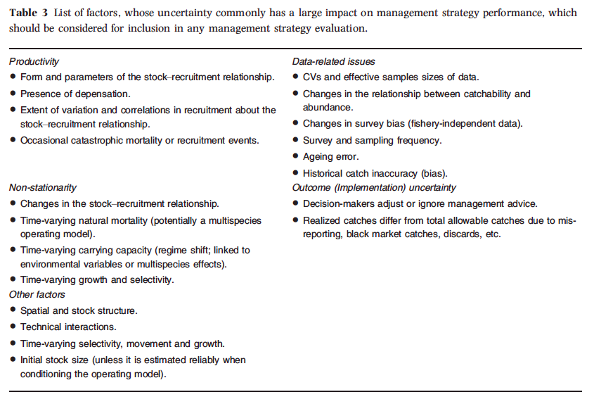
Uncertainties in MSE (operating model)
Punt et al. 2015. Fish & Fisheries

Slide 20
Conditioning Operating Models
Two general approaches:
Fit operating model(s) to available data for a particular stock, obtain estimates of uncertainty for parameters (e.g. through samples from the posterior distribution).
Analyses are tailored to stock of interest.
Magnitudes of uncertainty are ‘realistic’.
Create generic operating models that have characteristics of dynamics for stocks of interest.
Larger range of scenarios.
Perhaps make inference about general performance of procedures, not tailored to specific fisheries.
Might have to do more analyses to cover range of possible uncertainties.

Slide 21
Monitoring data
Management strategy includes specification of the data available to the assessment procedure and the harvest control rule.
These data should be generated by the operating model, but be plausible data that are or could be available in the real world.
The operating model should strive to make these data as ‘realistic’ as possible
e.g. include autocorrelation, bias, imprecision, etc.

Slide 22
Assessment procedures
These may range from simple to complex.
Simpler procedures may be indistinguishable from the harvest control rule.
Can reflect actual assessments conducted.
e.g. embed your statistical catch at age model in the estimation procedure.
Alternative is to make the assessment procedure very simple, and calibrate the performance of the management procedure through testing.
e.g. trend in mean catch rate, mean weight, etc.
Some consider this the goal for these analyses

Slide 23
Harvest Control Rules
Translate the results of the assessment procedure into scientific advice that can be used for management.
e.g. turn estimate of stock status into catch advice for next year.
Many (many) types of harvest control rules have been tested using MSE, ranging from those based on model estimated quantities, to simple empirical procedures.

Slide 24
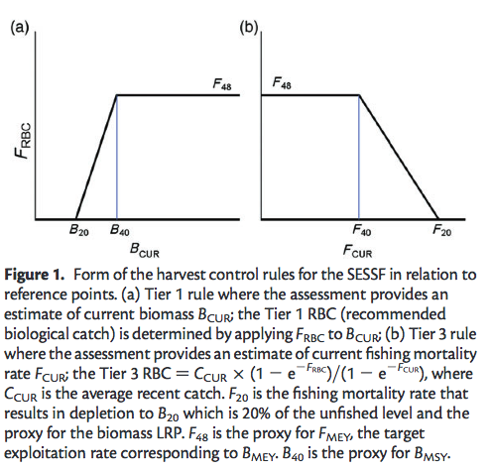
Model-based Harvest Control Rules in SESSF
Smith et al. 2014. ICES JMS

Slide 25
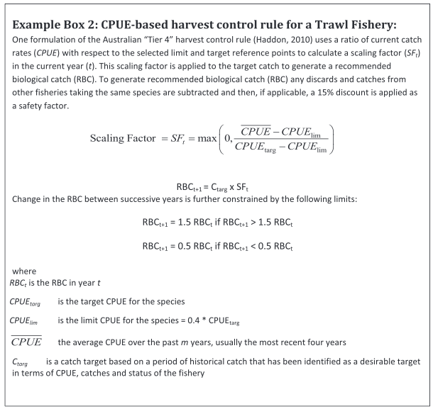
Empirical Harvest Control Rule using CPUE
Little et al. 2011

Slide 26
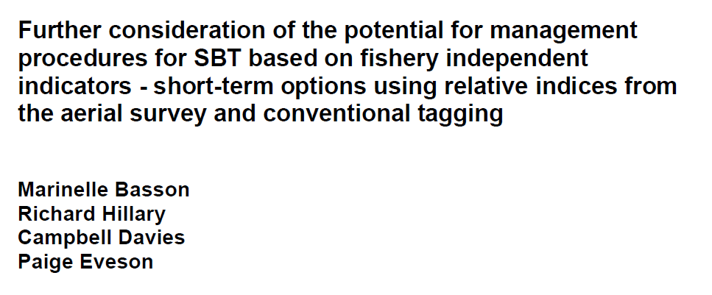
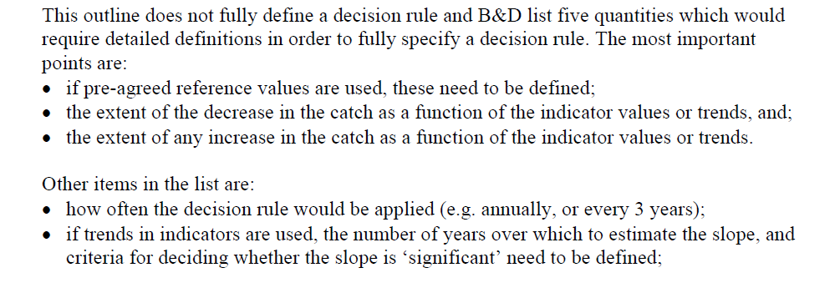
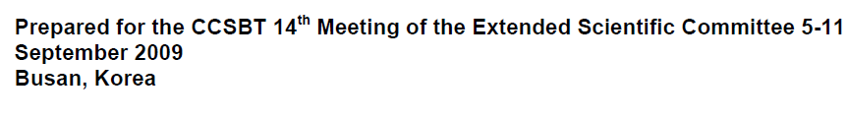

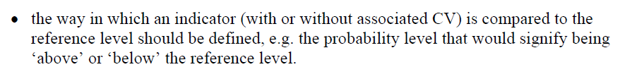

Slide 27
Performance measures
(the ‘evaluation’ part)
These should relate to tactical and strategic management objectives.
Can relate to ‘true’ or ‘perceived’ state of system (e.g. operating model vs assessment model)
Various objectives may prescribe complexity of operating model (need to include habitat effects, wages and employment, etc.)
At a minimum, performance measures should include:
Yield based metrics (e.g. average annual catch)
Stock Biomass metrics (e.g. distribution for B/BMSY, P(B>BLIM), etc.)
Inter-annual stability of catch advice (e.g. how often the control rule closes the fishery)

Slide 28
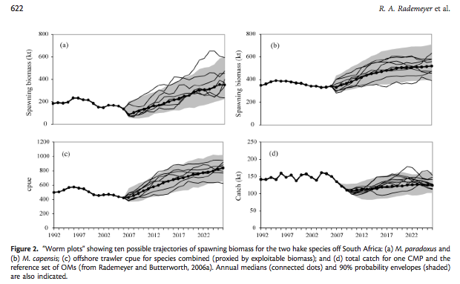
Visualizing performance (worm plots)
Rademeyer et al. 2007 ICES JMS

Slide 29
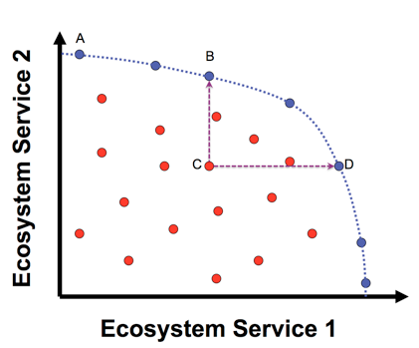
Evaluating Trade-offs
View performance of management strategies against multiple objectives or system traits.
A, B, and D are management options that are optimal solutions for one objective given a value for the other.
Management options in red are sub-optimal for both objectives.

Slide 30
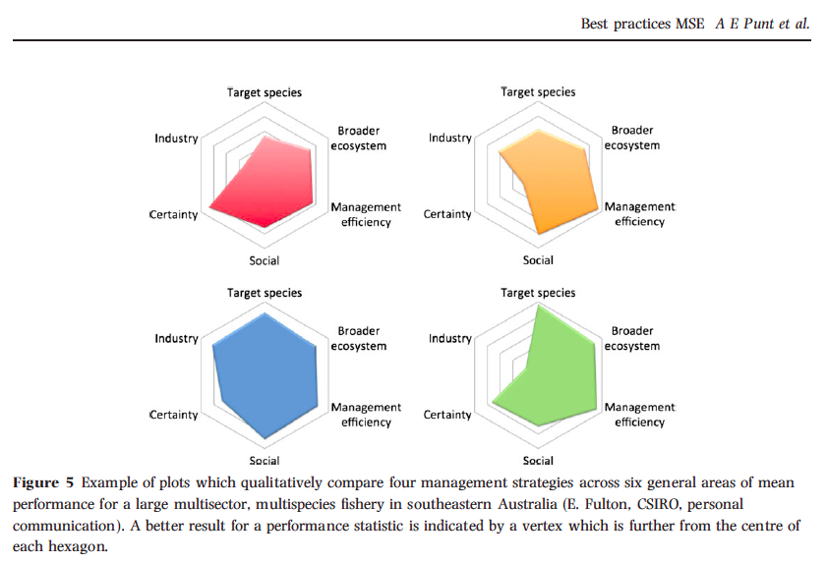

Slide 31
Examples from down under

Slide 32
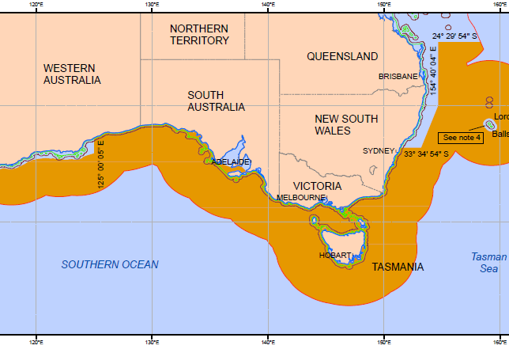
Southern and Eastern Scalefish & Shark Fishery ~20,000 tonnes of fish annually, $95 million AUD

Slide 33

Southern and Eastern Scalefish and Shark Fishery
Catches over 80 species of commercial value and is the main provider of fresh fish to the Sydney and Melbourne markets.
Precursors of this fishery have been operating for more than 85 years. Catches are taken from both inshore and offshore waters, as well as offshore seamounts.

Slide 34
MSE in the SESSF
MSE has been applied at system-wide level
ATLANTIS
Strategic purposes: quota controls, spatial management, capacity reduction
Single-species level used to evaluate harvest strategies
Operating models are parameterized by using the biological parameters that are estimated (and assumed) in the base-case assessment for a species
Assessment models are those actually used for determining catch levels.

Slide 35

Evaluate current SESSF harvest strategies against the HSP: all Tiers
Results for flathead
(30 yr projection)
All Tiers guide the stock close to the target, except for Tier 4 which will only work if the biomass in the reference period corresponds to the target biomass.
All Tiers lead to a median minimum depletion above the limit
P(below limit) is the proportion of times in the projection period that the biomass is below B₂₀, averaged over the simulations – for all Tiers this is less than 10%
Notes:
T1 – fully quantitative, T3 – age data in catch curves, T4 – CPUE, avlen – average length
Shows that all Tiers meet objectives of HSP (except T4 if ref period wrong)
T4 will guide the stock to the target it is given, in this case the biomass in the reference period is below the target.

Slide 36

Testing impacts of environmental forcing of recruitment on harvest strategy performance.
Stock-recruit relationship
Log recruitment deviations
Jackass morwong (Nemadactylus macropterus)
Recent stock assessments suggested below average recruitment since late 1980s.
Suggests a change in morwong productivity
If this has occurred, future recruitments predicted by the stock assessment model will always be optimistic, and catch targets will not be appropriate.

Slide 37
Recruitment under the regime shift model
Original base-case
Regime shift model

Slide 38
MSE scenarios
We have no choice about whether there has been productivity shift or not – it has either happened, or has not
But we do have a choice about what to assume in the assessment
MSE can investigate the implications of making the wrong choice
Four possible situations are tested by the MSE:
reality | assessment
no shift | no shift
no shift | shift
shift | shift
shift | no shift

Slide 39
All 4 possibilities
No shift, B0 in 1915
Shift, B0 in 1988
we were right
we were wrong
we were right
we were wrong
Notes:
Only showing last 20 years, LHS Bo is in 1915, RHS B0 is in 1988
If shift is true or not, if you assess as shift, catch is higher in short term, lower in long term
Assessing with regime shift is not a risk to the stock; if no regime shift and we assess with regime shift, long term catch is not greatly lower than if we assess without regime shift.

Slide 40
Morwong MSE results summarized
a)true: no shift; assess: no shift b) true: no shift; assess: shift
c)true: shift; assess; shift d)true: shift; assess: no shift

Slide 41
Regime shift conclusions
It is not risky to the stock to assume a productivity shift has happened – if it hasn’t but we assume it has then in the long term the stock stabilises above the target at 0.55 B0
If we continue as before, and the productivity shift has occurred, the stock does not reach the target in the long-term – it stabilises at 0.40 B0
For both mismatch scenarios the probability of being below the limit in the long term does not exceed 10% i.e. the risk criterion of the Harvest Strategy Policy is satisfied
However, it is more precautionary to assume the productivity shift has happened.

Slide 42
New/Current directions in MSE
Inclusion of wider range of societal objectives
Bio-economic analyses
Fleet dynamics – more coupling of models of human behavior to population dynamics models
Ecosystem-based MSEs
Multispecies/ecosystem models as operating models
Test performance of single-species assessment models / control rules in the context of ecosystem dynamics

Slide 43
Additional Issues
Defining objectives, performance measures, operating model scenarios, and management strategies.
This should be done in an iterative participatory process with stakeholders.
Exceptional circumstances
Specify situations that the management strategy hasn’t been tested against, or when it is likely to fail.
Ideally, there should be rules in places as to what to do (more data, review assessment method) when these occur.

Slide 44
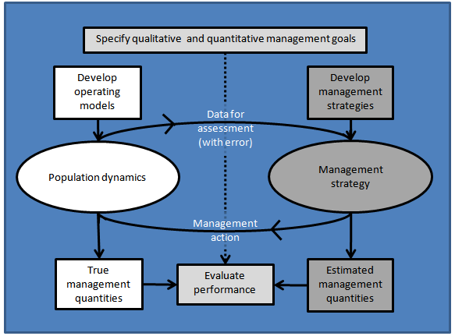
redrawn from Szuwalski + Punt (2013)

Slide 45
Computational Issues (rules of Punt)
Rule 1: The management strategy should not know more than it could in reality
Code the management strategy as a DLL or a separate program and use system to call it.
Rule 2: Coding the operating model is important!
Base the operating model on existing software
Conduct simulations in which there is no (or limited) error (you can then check whether performance is correct)
Use the same random numbers for all simulations.
Rule 3: Choose the number of simulations correctly
The number of simulations depends on how accurately your outputs should be (e.g. is the probably of collapse > 1% would take very many simulations to estimate correctly)

Slide 46
MSE vs other approaches (e.g. stock assessment)
PROs
Requires formal objectives and performance measures to be specified.
Feedback control allows whole of management tcycle to be evaluated
Full uncertainty can be built in.
Implications of policy built-in via feedback. “Closing the loop”
Formal system for comparing actual management performance among options AND hypotheses for state dynamics
Tradeoffs associated with multiple objectives explicitly addressed.
CONs
Require formal objectives and performance measures.
Complex, specialized expertise required (that’s where you come in).
Take time to develop.
NOT a substitute for stock assessment.
Do not explicitly provide tactical advice (as do stock assessments)
Particularly in EBM contexts, range of required expertise much broader than single-sector fishery managers.
Difficult to communicate complicated results
Notes:
Perhaps an option for ‘off years’ to understand the consequences of choices/assumptions in stock assessment models (e.g. specifying M, etc.)

Slide 47
What’s Next?
Project reports due 12/8
Oral presentations 12/15
Questions?

Slide 48
Lab exercise, doing an MSE
Evaluate performance of CPUE-based Harvest Control Rule for Sebastes electronicus
Operating model
Age-structured model (based on fit of statistical catch at age)
Assessment model
Value of CPUE relative to target
Harvest control rule
SESSF Tier 4 CPUE rule

